Slide 1


WELCOME TO THE PRESENTATION on
SOCIO ECONOMIC DEVELOPMENT (SED)
By
Nizam Mohammed Uddin
President
ORG Foundation Bangladesh

Slide 2
NIZAM MOHAMMED UDDIN
ABOUT
Graduated from Dhaka University.
Master of Business Administration (MBA) in International Management from Switzerland.
Master of Project Management (MPM) from University of Dallas, Texas, USA.
Associate degree from “British Columbia Institute of Technology (BCIT) Vancouver, BC, Canada.
and Program completed on Financial Strategy from, IBA, Dhaka University, Bangladesh.
Doing Agriculture Micro Research to develop total life style in rural area last 13 years.

Slide 3

FOCUS
To protect the Low income people of Bangladesh by taking baby steps to Shine the light of technology and transform each village to a self-sufficient entity and to provide them with a stronger step to a better life.
To protect the Low income people of Bangladesh by taking baby steps to Shine the light of technology and transform each village to a self-sufficient entity and to provide them with a stronger step to a better life.

Slide 4
BOARD OF TRUSTEE
MD. NIZAM MOHAMMED UDDIN I President
FARZANA AFROZ I Vice President
SELINA SULTANA I Treasure
HASINATUN NAHER I Cultural Secretary
MD. AMANULLAH CHOWDHURY I Social Welfare Secretary
RIDWAN RENAN AHMED I Education and Cultural Secretary
SABBIN AKTER I Executive Member
SABERA CHOWDHURY I Executive Member
RIFFAT SAMINA I Executive Member

Slide 5
BOARD OF TRUSTEE
HUSSAIN MOHAMMAD ASHAR I Executive Member
SHARMIN SULTANA I Executive Member
KAZI NAHID PARVIN JESIN I Executive Member
TANJARA BINTE ANSAR I Executive Member
RASEL MAHMUD I Executive Member
SHAHPAR SULTANA AHMED RINKY I Executive Member
SADRUDDIN AHMED I Executive Member
AFROZA AHMED I Executive Member
MOSHIUR RAHMAN SUMON I Executive Member

Slide 6
BOARD OF TRUSTEE
AMINUL HAKIM I Executive Member
SHAMSUDDOHA TAPOS I Executive Member
MD. MOHAMMAD HANIF YAHIA I Executive Member
SYED RUMELLA ZAMAN AL HUSSAINI I Executive Member
TAHRIMA AHMED I Executive Member

Slide 7
ORG FOUNDATION BANGLADESH
PROVIDES
SOCIO ECONOMIC DEVELOPMENT (SED)
For Farmer, Fisherman & Daily Labor
in Bangladesh

Slide 8
VISION & MISSION
To protect the Low/Average income people as a member of ORG Foundation Bangladesh.
Large portion of our nationals are fallen in low income group.
63% are involved in Agriculture Sector .
11% are working as labor.
26% are involved in other variety of sectors.

Slide 9
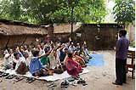
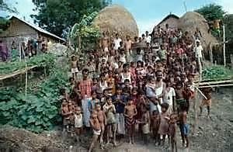
BANGLADESHI COMMUNITIES
I have been enlightened by communities and we all have agreed to reshape resources allocations, enact and communal community development project using the ORG’s entity conscious project infusion technological transfer methodologies.

Slide 10
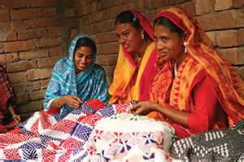
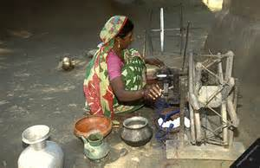
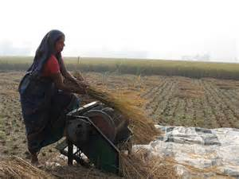
EACH VILLAGE HAS IT’S OWN BUSINESS ID
Each village has already formed themselves as a Bangladesh business entity. They have created an internal delegation to manage the grass root communal community development level.
They have taken the first step to establish the base plan of the desired community needs with a base projected cost model that has been submitted to the ORG entity conscious summation board.

Slide 11
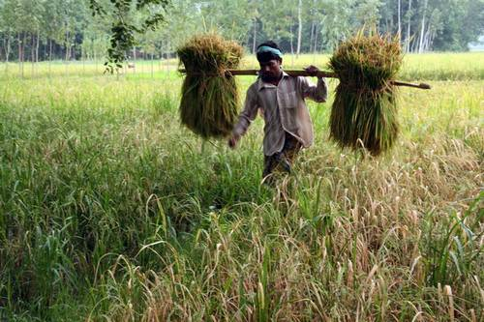
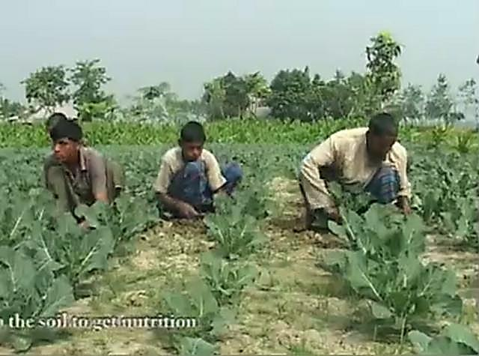
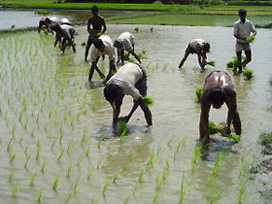
COMMUNITY CASH COMMODITIES
Preparing alternatives using my awareness training from ORG entity conscious, I have established a unique strategy to help the grass roots farmers view a realistic business scenario and designed and implement a work flow system that will allow them to create immediate jobs triggering new training methods for agriculture techniques in hydroponics, soil restoration, water treatment, seed containment. Also triggering technologies for green power with agriculture technology, communication and data networking, emphasizing new business and product development with maintenance warehousing, product packaging and storage just to name a few.

Slide 12

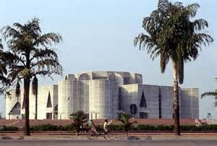
GOVERNMENT TAKE A CLOSER LOOK
It is my belief as Bangladesh Businessman that utilizing my training and global expertise, this community can create an effective Socio Economic Development strategy, which can be a vital image for thousands of Bangladeshi farmers.
Bangladesh can even become a training ground and example for many under developed poor communities around the globe. Displaying how to reshape their resource allocations to become self sufficient by removing poverty from themselves and their communities by using TECHNOLOGY.

Slide 13
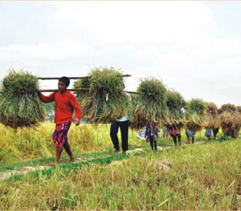
BANGLADESHI FARMERS’ & LAND
Commodities can be traded into the global market place as a revenue generator to create jobs, pay salaries and funds to sponsor community development projects like school, power, this plan calls for the formation of the community socio business where communities pool their lands natural resources to produce an agricultural commodities. These commodities are run by agriculture waste. TECHNOLOGY can remove all obstacles.

Slide 14
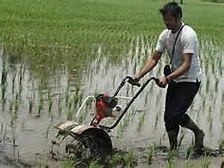
CREATING SMART ALLIANCE
The SED business can request a development alliance to support the effort by supplying to the Socio Business by using Technology:-
Product specific inputs
Agriculture Technology transfer
Global Business Education by technology
Marketing support in real time
International business management training for the indigenous
Global Network Infrastructure for business to business collaboration and commodity sales.
In return the alliance receives a commodity produced based on their specifications for their international business clients.
Truly a WIN-WIN for the community and the Alliance.

Slide 15
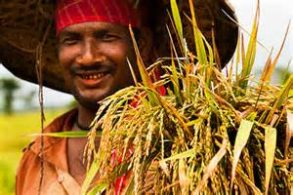
SOCIO ECONOMIC DEVELOPMENT
By using the “Socio Economic Development” (SED) Model instead of privatization Bangladesh farmers can gain the highest degree of profit with a long term benefit. SED does not remove the resources from the people. Profits are more equally spread and the venturing partner becomes the first customer of the community development SED.
This is WIN-WIN situation again.

Slide 16
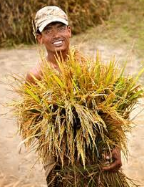
SOCIO ECONOMIC DEVELOPMENT ...Continue
What I will do is demonstrate and help this community of business create an alliance where from day one they are equal to the SED alliance. Again this changes the profit ratios having the right SED Alliance can mean ratios as high as 87% margin to the community SED
Still maintaining ownership of the land and entire business resources.

Slide 17
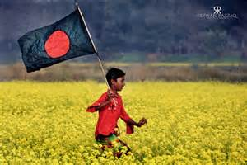
HIDDEN STRENGTH OF THE BANGLADESHI FARMERS
Also remember, since the community are formed as a business and create an Alliance. They are asking Government acknowledgement. As such ORG Foundation got approval letter from Ministry of agriculture and Ministry of Rural Development.
Their input come from the SED Alliance, this is part of the SED agreement structure. It means direct simulation into the communities.
Bangladesh Government will realize that this type of project as a program for Bangladeshi farmers. This will open a new flood gate of new Alliance looking for ready scenarios to make marginable gains. Farmers across the country will be benefitted instantly by using this program called Technology in Agriculture.

Slide 18
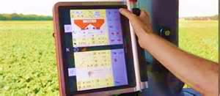
GROUP OF PROFESSIONALS
I have sourced a group of professionals, they are willing to create a prototype solution for a few business communities that I have handpicked. Kanaipur (Faridpur Dist), Kashiany (Gopalgoang Dist), Nandina (Jamalpur Dist), Tetulia( Panchagar Dist).
The group of people called ORG (Organization for Rural Governance ).
As I have Government appreciation letter. I have my team ready to start this SED program within those communities immediately with the financial support of your Organization.

Slide 19
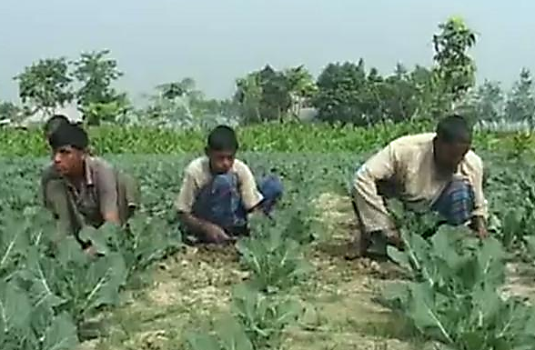
THE SO CALLED POOR FARMERS
As we called our farmers are poor but it is not true and I strongly believe that through our ORG program which is called “Socio Economic Development (SED)” through Technology we can make them independent no matter what. Farmers they don’t have to beg, they don’t have to change their profession, they don’t have to rush to the city to do some non professional work which they are not supposed to do at all. Only Technology in Agriculture can do that for them.

Slide 20
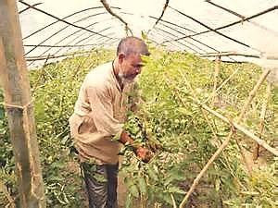
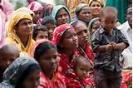
FARMERS’ ADVANTAGE FROM “SED”
From this “Socio Economic Development” program farmers’ don’t need to borrow money from local money lenders to do the cultivation. Other hand land owner also don’t need to invest money for this cultivation.ORG will provide assistance to the farmers to buy seeds, fertilizer, pesticides ,water supply etc. Also ORG will provide all kind of farming equipment to the farmers for cultivation.

Slide 21
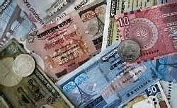
FARMERS’ DEBT
By the present design/climate in Bangladesh total cultivation time is around 15 days. So farmers get paid for those 15 days only. What about rest of the days in the season!?That’s really painful. They borrow money from local money lenders by committing high interest for their living. As soon as they get the crops ,they sell them to pay their debt to the lenders. After paying debt they have nothing left. Back again to poverty. But ORG technology in Agriculture program can take them out of poverty and they can have a decent life style.

Slide 22
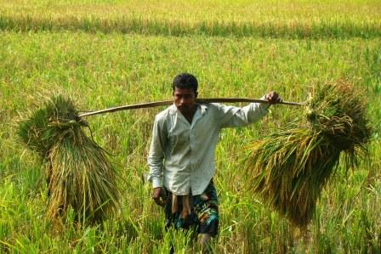
FARMERS JOB SAFETY
ORG will employ those farmers around the year. After the cultivation they will be provided by different kinds of work by ORG. For example union cleaning, collecting seeds for the next season as per the demand and requirements.
As a result they don’t need to borrow money from money lenders by paying high interest.

Slide 23
Farmers Faridpur
Technology
can get them out of
Poverty rapidly
Canada
Edmonton
ORG Server Dhaka
USA
New York
Farmers Panchagar Dist
Farmers Jamalpur Dist

Slide 24
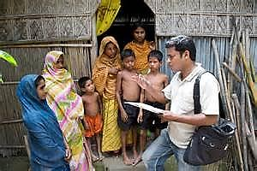
EDUCATION FACILITY
Farmers and their families will get proper farming education from ORG specialized agriculturist from Canada/USA/Japan/Germany and local as well by video conferencing.
In this program ORG will not pay anything to foreign expert or consultant. We will take 100% local expert and will take ONLY advice from ORG overseas expert .

Slide 25
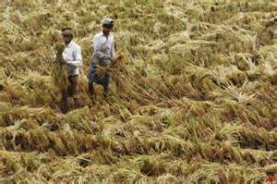
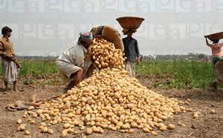
CROP SHARING
End of the season when we get the total yield of crop we will divide them as per the formula in Bangladesh which is 50% ratio.
As per our SED formula farmers/land owners will have more production than before as such they will have much more money for their living.
On the other hand they don’t have any debt as they got all support from ORG.

Slide 26
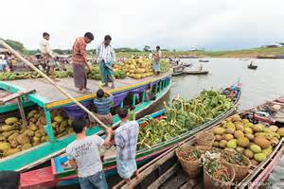
MARKETING SUPPORT
Most of the time farmers/landowners they want to sell their products to buy their other house hold items but lack of knowledge they can’t get the right price for their products.
The middlemen take advantage and buy the products in low price.
ORG Foundation Bangladesh will assist them to sell their all non traditional products within the country and in overseas market by using Technology to get the best price.

Slide 27
THANK YOU
MAY GOD
BLESS BANGLADESH

